Slide 1
Code Packaging
Create the right environment for your code
*Part of materials adapted from missing-semester, MIT

Slide 2
Dependencies
For most cases, our programs/applications/code depends on some external package that are not part of the native runtime
So we need to install them in our local filesystem, but such a library may also depends on other libraries, which creates a chain of dependencies
And there are many versions of the same package, which may cause dependency conflicts

Slide 3
Tools
In this session we are going focus on Python programming language
In python, the installation tool is denied by several specifications, meaning that there are multiple tools for us to use that follows the same specifications
The classic one is pip, and developers have created more optimised tool like uv

Slide 4
Virtual environments (venvs)
To avoid installing too many packages and causing dependency conflicts, the best practice is to create a virtual environment for each program, and install packages inside those virtual environments
You can think of virtual environments as a fresh copy of the runtime, each with its own set of packages
Virtual environments isolates the installed dependencies from the global dependencies (and other virtual environments)

Slide 5
Creating venvs
First, to check which python runtime you are using, type:
  which python
  This will print out the path to the current runtime you are using
Then, to create a venv:
  python -m venv <name>
Before you install packages, you will need to activate your venv, use:
  source <path_to_your_venv>/<name>/bin/activate

Slide 6
Creating venvs
After you created and activated your venv, you can download packages by
  pip install <pakcage_name> or
  uv pip install <package_name> is faster
To deactivate your venv, simply type
  deactivate
You can also set a specific python version when you create the venv (requires the corresponding python on your computer)
  python3.11 -m venv <name>

Slide 7
requirements.txt
Sometimes we might have installed too many packages into a venv, and it might be hard to track all of them
So this becomes a problem when we want to run the same piece of code on another device, we will have to create the venv again
A common solution is to include a requirement.txt in our repo, and then install packages from that file

Slide 8
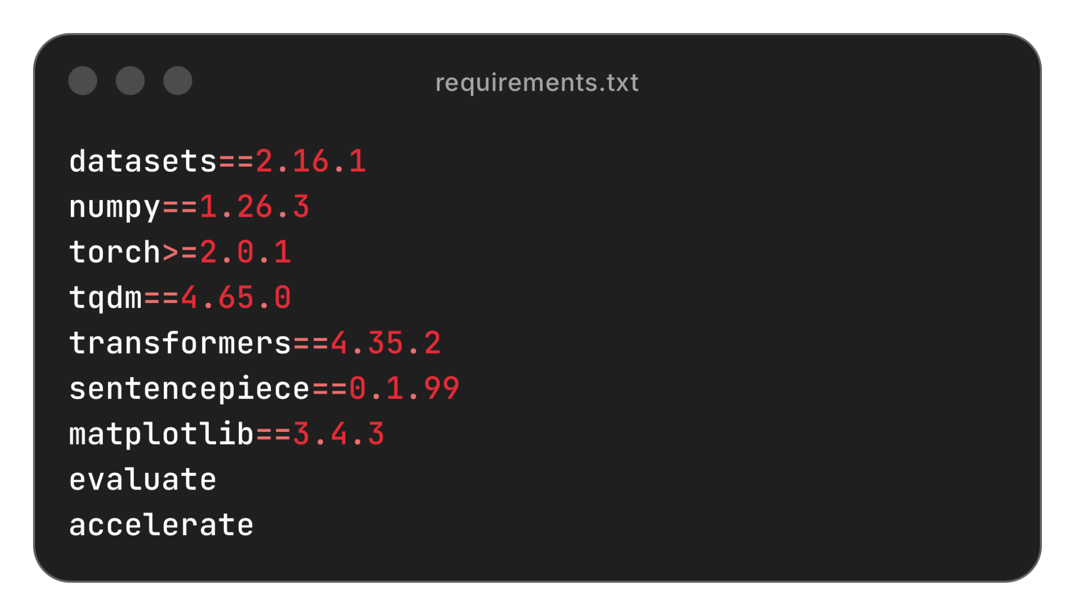
requirements.txt
As shown, this is a really simple file that allows you to define all packages needed, together with the versions
Then, you can create a fresh venv and install all the listed packages:
  (uv) pip install -r <path_to_file>/requirements.txt
You will see this pattern in may research code bases

Slide 9
Create your packages

Slide 10
Packaging
While requirements.txt gives a simple and straightforward way to create the same environment, but it is not the best practice for creating a package that can be run anywhere
To do this we need to create an artifact (that is called a wheel) so that the package installers (pip, uv) can use to install the relevant files
To build such an artifact we need to write a project file, pyproject.toml

Slide 11
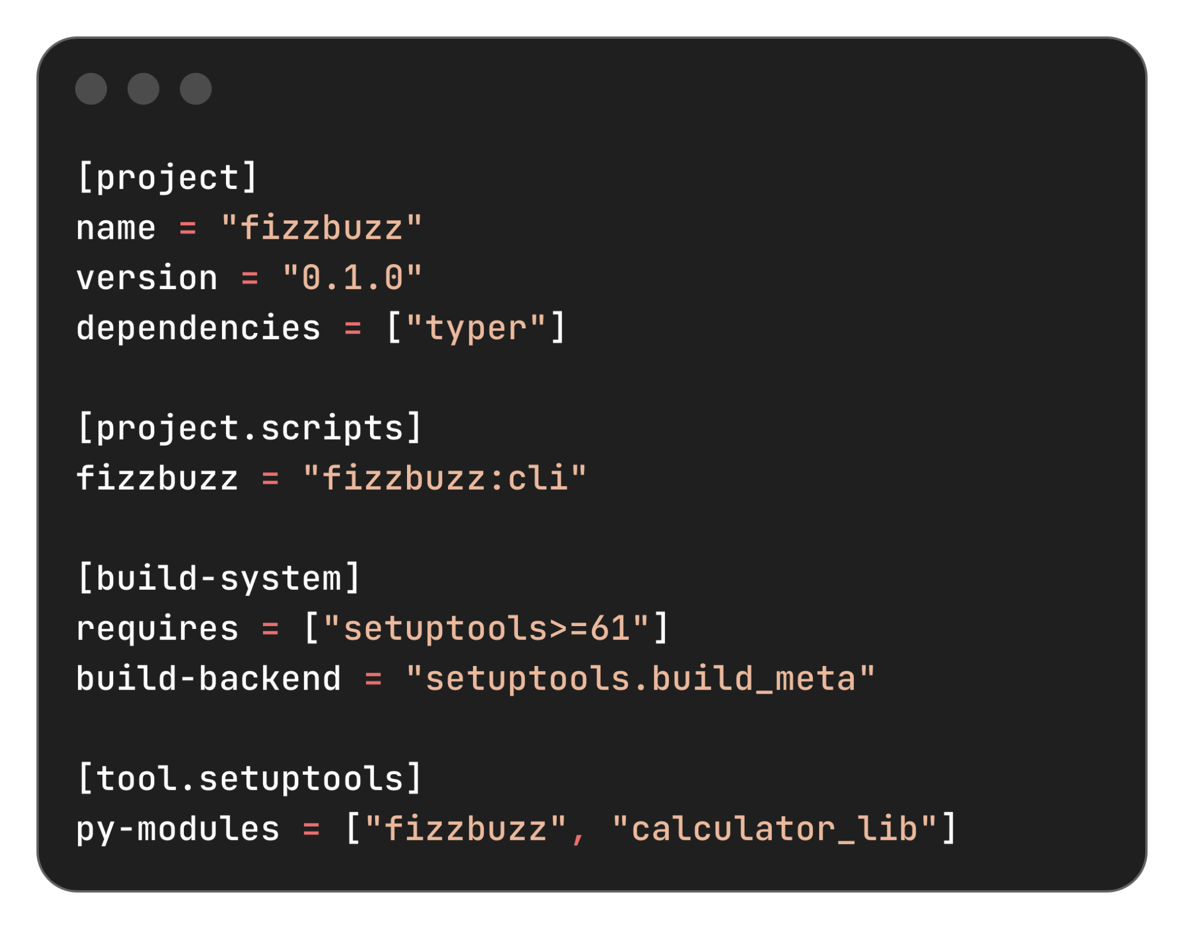
Creating packages
Take our old calculator project as an example, write a .toml file as shown on the right:
[project] section lists the basic info about the package, including version, dependencies, name
[project.scripts] section defines the command and the function to run for command line
[build-system] section specify the setup tool to build the artifact
[tools.setuptools] section tells the setup tool what python files to include in the final wheel

Slide 12
Build and install the package
When you have your toml file ready, you can build the wheel from it, use:
  python3 -m build (might need to install build), or uv build
Now you show see a folder called dist, it contains:
  A .tar.gz file for system that needs to build from source
  A .whl file which is the wheel we just built
Now, to install the from the wheel, we can use:
  (uv) pip install ./dist/<filename>.whl
After the package is installed, try type fizzbuzz in your command line

Slide 13
Some limitations
The previous method works fine when your code is not depended on architecture-specific compiled code
You will have to build separate wheels for different platforms (Linux, macOS, Windows), and architecture (x86, ARM) if you have such code
Alternatively you can distribute the source code and let users build from the source distribution, but this will take longer and require users to have the corresponding compiler and build tool
This is the difference between installing from source and pre-built binary

Slide 14
Versioning
As we have seen before, whenever you are installing or build packages, you need to be careful with the versioning
Under Semantic Versioning, the versions have a form of MAJOR.MINOR.PATCH, each of them are integer values
  PATCH (0.1.0 -> 0.1.1): Bug fixes, fully backwards compatible
  MINOR (0.1.1 -> 0.2.0): New functionalities added in a backwards compatible way
  MAJOR (0.2.0 -> 1.0.0): Make incompatible API changes

Slide 15
Containers

Slide 16
Levels of abstraction
What we have talked so far (wheels, etc.) are limited to the python programming language
  It assumes you have the system library and other OS supports
  And as we seen before, you will need different builds when you have architecture-specific compiled code
To address this issue we adapt a higher level of abstraction. That is, not only abstract the python environment, but also the system libraries, file system, etc.

Slide 17
VMs and containers
For this purpose we use VMs or containers, that can be run on any machine without separate builds
  VM are virtual machines that runs on the host machine, contain the complete OS which creates an isolate environment
  Containers are more lightweight and VMs because it utilises the host OS kernel, and only contain your code, some system library, etc. But not the complete OS
Modern industry prefers containers, and Docker is one of the most famous ones
  https://docs.docker.com/get-started/get-docker/

Slide 18
Docker images, containers, files
An docker packaged artifact is called a docker image
  To build such an image you will need to write a docker file that contains some command-like code to include the required dependencies
An image can be run anywhere, and a running instance of a docker image is called a docker container

Slide 19
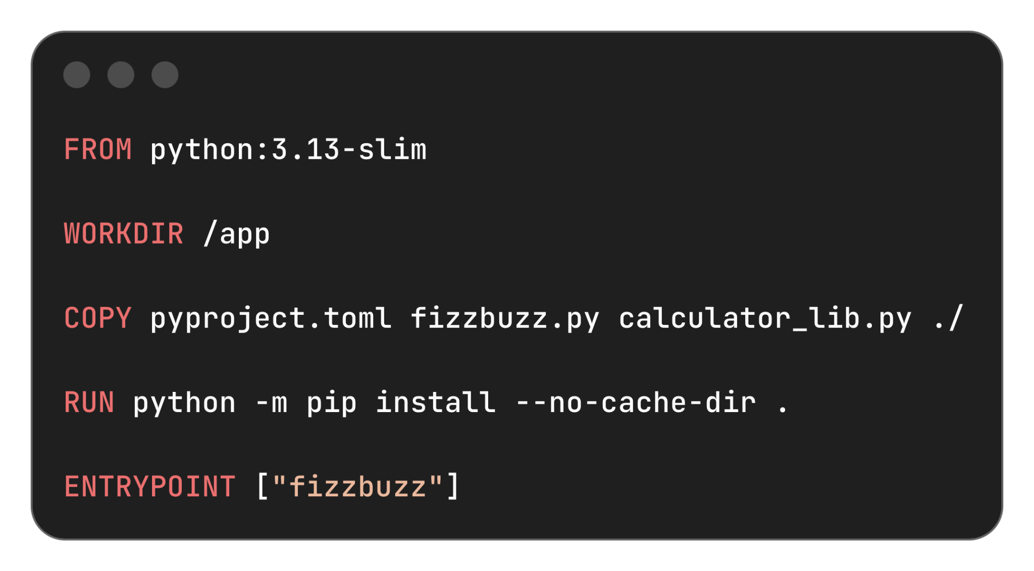
Write a dockerfile
As shown, this is a dockerfile for fizzbuzz program
Each line is an instruction that creates a new layer
  FROM selects a base image with python 3.13
  WORKDIR is the base directory in the image
  COPY copies local files to the work directory in the image
  RUN runs a command to installing our package
  ENTRYPOINT tells what command to run when a container is started

Slide 20
Build the docker image
After the docker file is ready, you can build the image using
  docker build -t <image_name> .
You can then view the list of images you have built using
  docker image ls
Since our fizzbuzz program is interactive, you need to run it with
  docker run --rm -it <image_name>

Slide 21
A little bit more about docker
Although docker provides a higher level of abstraction, but running a docker image build for a certain architecture (e.g. amd) is still very slow on a different architecture (e.g. arm)
There is a way to optimise your docker file so that it uses cached layers and will make the result image smaller, also build faster
It is a common pattern to have multiple container running, each for a different service, and combine them together
etc .

Slide 22
Thanks for Coming!

Slide 23
Table of contents (outline)
dependencies
virtual environment
  Create venv
  Download dependencies (from requirements.txt…)
toml files?
docker
  Container vs image
  Build & run image
  Run multiple dockers (introduction only)

